Slide 1


LSU CENTER FOR ACADEMIC SUCCESS
Empowering Students. Inspiring Success.

Slide 2

Notes:
CAS Services Video (long version)
https://www.youtube.com/watch?v=iIyspE9-OIQ

Slide 3
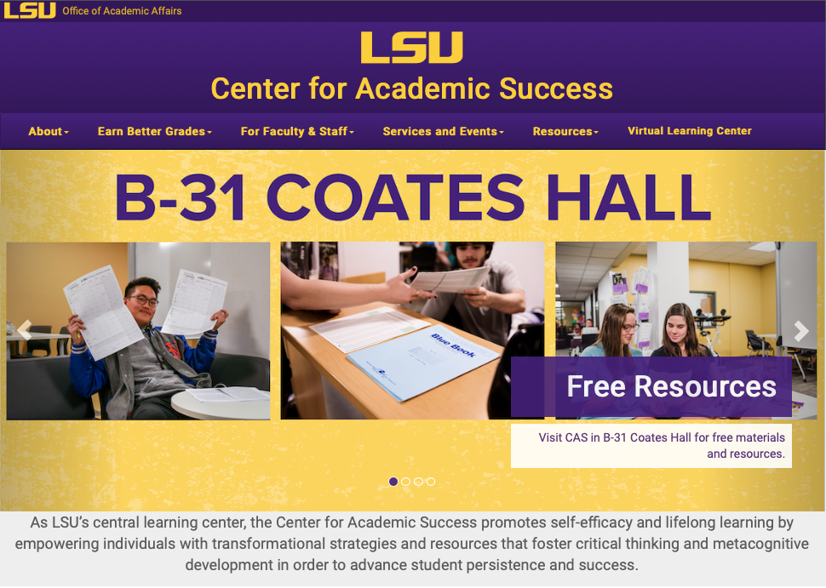
FREE ACADEMIC RESOURCES
LEARNING JOURNEY
SUPPLEMENTAL INSTRUCTION
SELF-LED RESOURCES ON MOODLE
SI OFFICE
B-39 ALLEN HALL
SIGNATURE STRATEGIES WORKSHOPS
TUTORING
SHELL TUTORIAL CENTER 141-B LSU LIBRARY
ONLINE TUTORING
900 MINUTES FREE
SEE LSU.EDU/CAS
TIME MANAGEMENT
LEARNING STRATEGIES
FINALS PREP
lsu.edu/cas
ACADEMIC COACHING
CAS MAIN OFFICE
B-31 COATES HALL

Slide 4

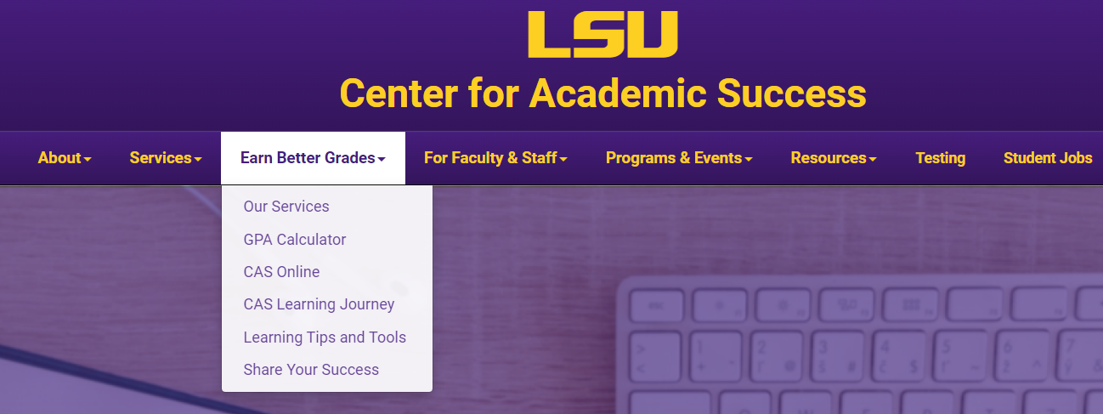


The CAS Semester Toolkit will help you organize your time, engage in your classes, and get the most out of your studying. Tap into these tools to help you excel in your courses all semester long!

Slide 5

SIGNATURE STRATEGIES

Slide 6
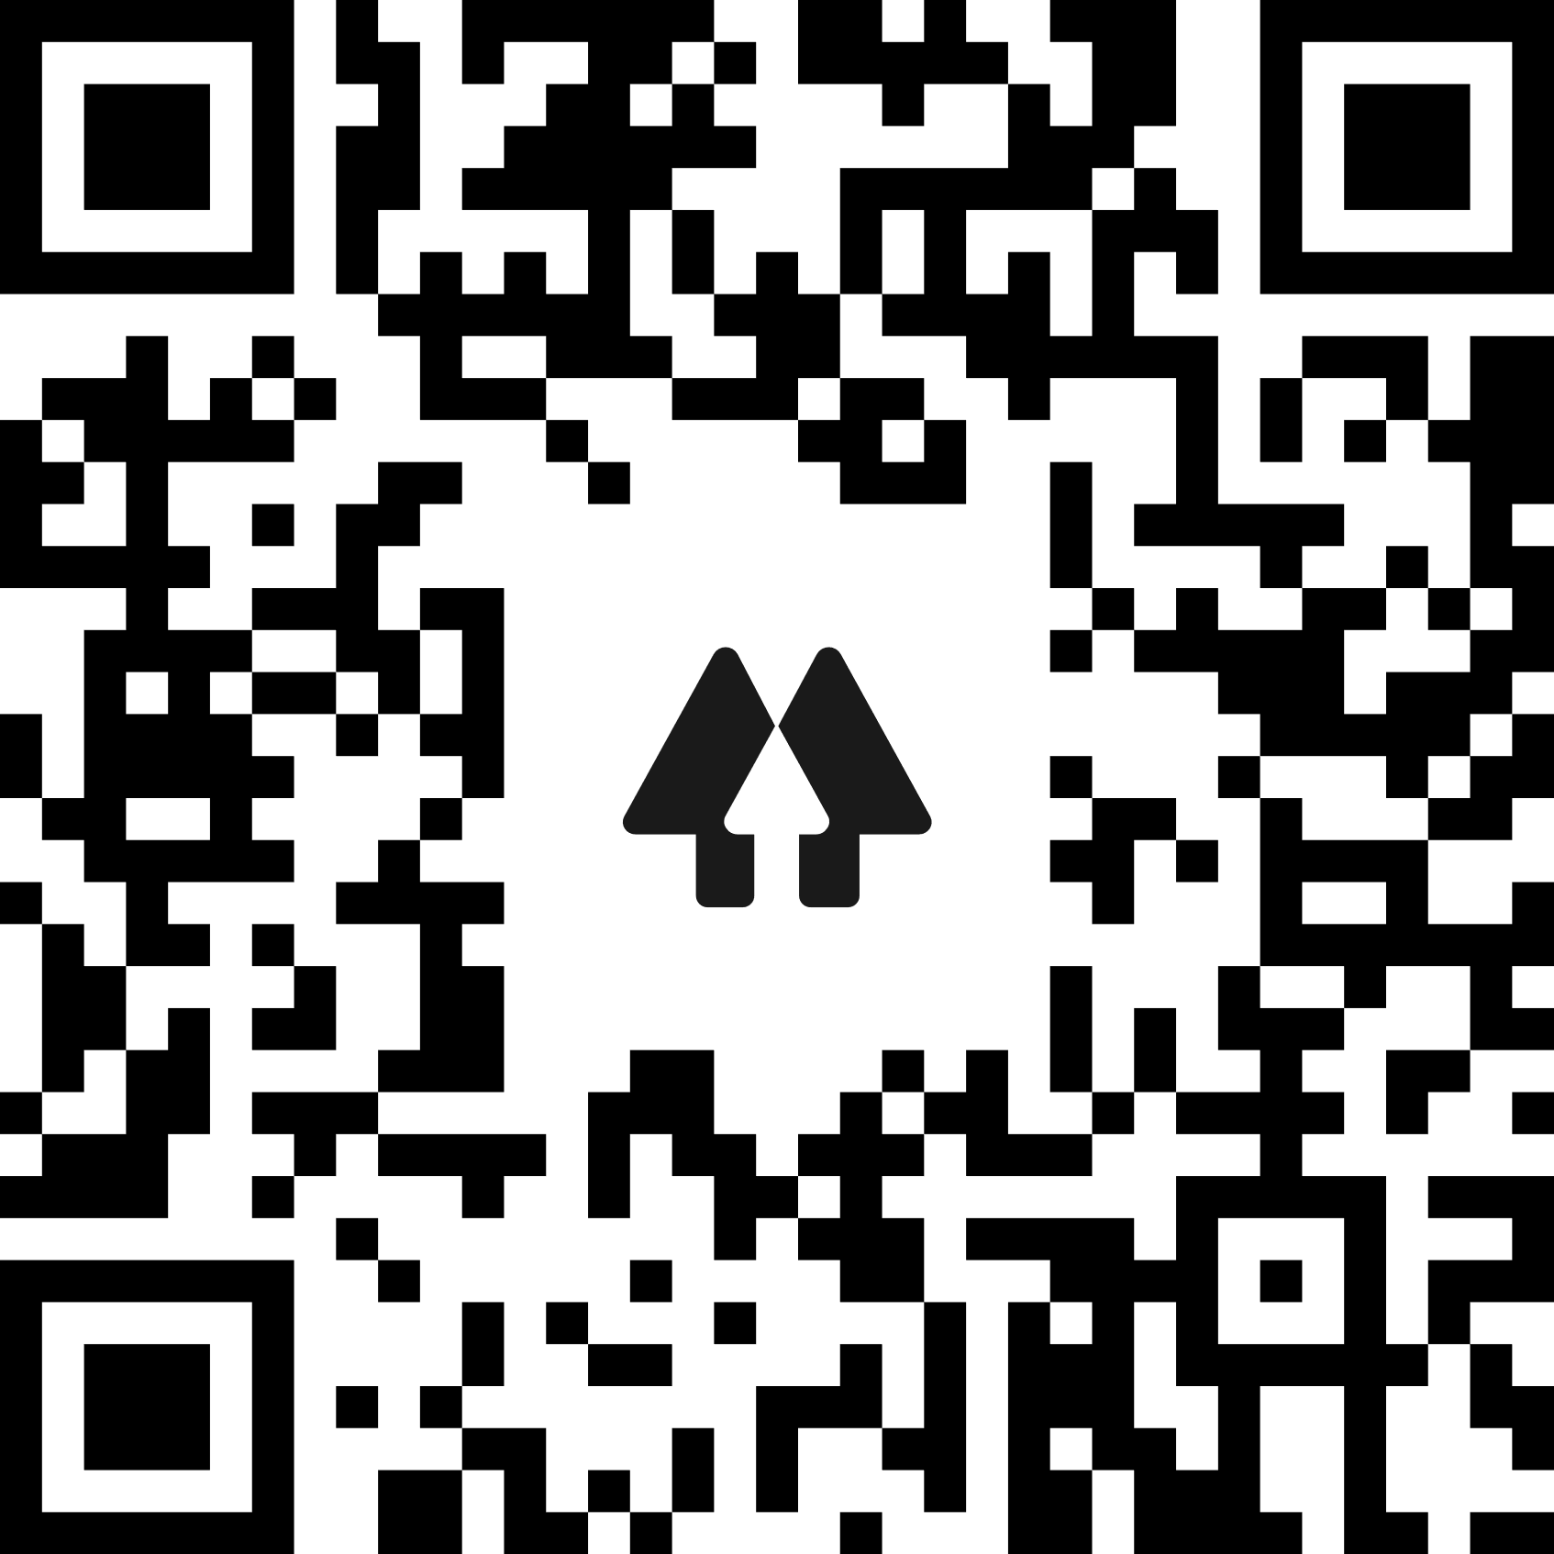
Learn more about CAS services and follow us on social media
Scan the QR Code

